Slide 1

“A PROJECT
REPORT ON
FLIGHT TICKET
PRICE PREDICTION”
SUBMITTED BY
HIMAJA IJJADA

Slide 2
TOPICS TO BE DISCUSSED
Introduction
Problem statement
Conceptual Background of the Domain Problem
Motivation for the Problem Undertaken
Mathematical/ Analytical Modeling of the Problem
Data Sources and their formats
Data Preprocessing Done
Visualizations
Model/s Development and evaluation
Interpretation of the Results
Key Findings and Conclusions of the Study

Slide 3
Introduction
Airline industry is one of the most sophisticated in its use of dynamic pricing strategies to maximize revenue, based on proprietary algorithms and hidden variables. That is why the airline companies use complex algorithms to calculate the flight ticket prices. There are several different factors on which the price of the flight ticket depends. The seller has information about all the factors, but buyers are able to access limited information only which is not enough to predict the airfare prices.
Considering the features such as departure time, arrival time and time of the day it will give the best time to buy the ticket. Nowadays, the number of people using flights has increased significantly. It is difficult for airlines to maintain prices since prices change dynamically due to different conditions. That’s why we will try to use machine learning models to solve this problem. This can help airlines by predicting what prices they can maintain. It can also help customers to predict future flight prices and plan their journey accordingly.

Slide 4
Problem statement
The main aim of this project is to predict the price of flight tickets based on various features. The purpose of the paper is to study the factors which influence the fluctuations in the airfare prices and how they are related to the change in the prices. Then using this information, build a system that can help buyers whether to buy a ticket or not. So, we will deploy Machine Learning model for flight ticket price prediction and analysis. This model will provide the approximate selling price for the flight tickets based on different features.

Slide 5
Conceptual Background of the Domain Problem
Flight ticket prices can be something hard to guess, today we might see a price, check out the price of the same flight tomorrow, and it will be a different story. We might have often heard travelers saying that flight ticket prices are so unpredictable. Anyone who has booked a flight ticket knows how unexpectedly the prices vary. The cheapest available ticket on a given flight gets more and less 2 expensive over time. This usually happens as an attempt to maximize revenue based on –
1. Time of purchase patterns (making sure last-minute purchases are expensive).
2. Keeping the flight as full as they want it (raising prices on a flight which is filling up in order to reduce sales and hold back inventory for those expensive last-minute expensive purchases).
Here we are trying to help the buyers to understand the price of the flight tickets by deploying machine learning models. These models would help the sellers/buyers to understand the flight ticket prices in market and accordingly they would be able to book their tickets.

Slide 6
Motivation for the Problem Undertaken
Air travel is the fastest mode of transport around, and can cut hours or days off of a trip. But we know how unexpectedly the prices vary due to the Dynamic pricing. So, I was interested in Flight Fares Prediction listings to help individuals and find the right fares based on their needs. And also, to get hands on experience and to know that how the data scientist approaches and work in an industry end to end.

Slide 7
Mathematical/ Analytical Modeling of the Problem
We need to develop an efficient and effective Machine Learning model which predicts the price of flight tickets. So, “Price” is our target variable which is continuous in nature. Clearly it is a Regression problem where we need to use regression algorithms to predict the results. This project is done on three phases:
• Data Collection Phase: I have done web scraping to collect the data of flights from the well-known website www.yatra.com where I found more features of flights compared to other websites and I fetch data for different locations. As per the requirement we need to build the model to predict the prices of flight tickets.
• Data Analysis: After cleaning the data I have done some analysis on the data by using different types of visualizations.
• Model Building Phase: After collecting the data, I built a machine learning model. Before model building, have done all data pre-processing steps. The complete life cycle of data science that I have used in this project are as follows:
Data Cleaning
Exploratory Data Analysis
Data Pre-processing
Model Building
Model Evaluation
Selecting the best model

Slide 8
Data Analysis steps :
Import Libraries
Import Dataset
Data Pre Processing
Ordinal encoding
Visualization
Finding null values

Slide 9
Data Sources and their formats
We have collected the dataset from the website www.yatra.com which is a web platform where one can book their flight tickets. The data is scrapped using Web scraping technique and the framework used is Selenium.
We scrapped approximately 5300 of the data rows and fetched the data for flights between different locations and collected the additional information of different flights and saved the collected data in excel format. The dimension of the dataset is 5303 rows and 9 columns including target variable “Price”.

Slide 10
Data Preprocessing Done

Slide 13
Assumptions
This gives the statistical information of the dataset. The summary of this dataset looks perfect since there is no negative/ invalid values present. It gives the summary of numerical data.
From the above description we can observe the following things
The counts of every column is same which means there are no missing values present in the dataset.
The mean value is greater than the median (50%) in the columns Duration, Number_of_stops, and Price so we can say these columns are skewed to right.
The median (50%) is bit greater than mean in Departure_Hour, Departure_Min, Arrival_Hour, Arrival_Hour and Arrival_Min which means these columns are skewed to left.
From the description we can say the minimum price of the flight ticket is Rs.3362.00 and maximum price is Rs.30954.00 also the mean is 10744.987366.
In summarizing the data we can observe that there is huge difference in maximum and 75% percentile in the columns Price, Duration, etc that means huge outliers present in those columns. These differences can also be seen in many other columns. So we need to remove outliers and skewness to get better model and prediction.

Slide 14
Software Used
Distribution: Anaconda Navigator
Programming language: Python
Browser based language shell: Jupyter Notebook
Chrome: To scrape the data

Slide 15
Visualizations

Slide 16
Observations:
Airline: From the pie plot we can infer that there are more number of flights of "Air India", "Vistara" and "Indigo" compared to others. Also, the count of Spicejet flights are very less.
Number_of_stops: From the above pie plot we can infer that 64% of the flights have only 1 stop during the journey and some of the flights (20.6%) have 2 stops where only few flights have 3 and 4 stops.

Slide 17
Observations:
Meal_availability: Most of the flights providing free meals and only few flights are not providing any meals.
Source: From the count plot we can observe more number of flights are from Mumbai, New Delhi, Jaipur, Kolkata and Bangalore. Only few flights are from Hyderabad.
Destination: More number of flights are heading towards Lucknow, New Delhi and Kolkata. Only few flights are travelling to Hyderabad.

Slide 18
Observations:
Above plot shows how the data has been distributed in each of the columns.
From the distribution plot we can observe the columns are somewhat distributed normally as they have no proper bell shape curve.
The columns like "Duration", "Number_of_stops" and "Price" are skewed to right as the mean value in these columns are much greater than the median(50%).
Also the data in the column Arrival_Hour skewed to left since the mean values is less than the median.
Since there is presence of skewness in the data, we need to remove skewness in the numerical columns to overcome with any kind of data biasness.
Observations:
Airline vs Price: From the bar plot we can notice "Vistara" and "Air India" airlines have highest ticket prices compared to other airlines.
Number_of_stops vs Price: From the strip plot we can notice the flights which have 1 and 2 stops between source and destination have highest ticket prices compared to others. The airlines which have 4 stops during the journey have very less ticket price. So we can say as the stops increases, ticket price decreases.

Slide 19
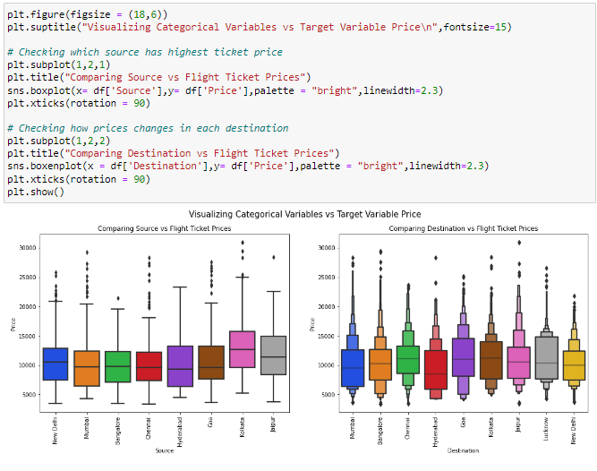
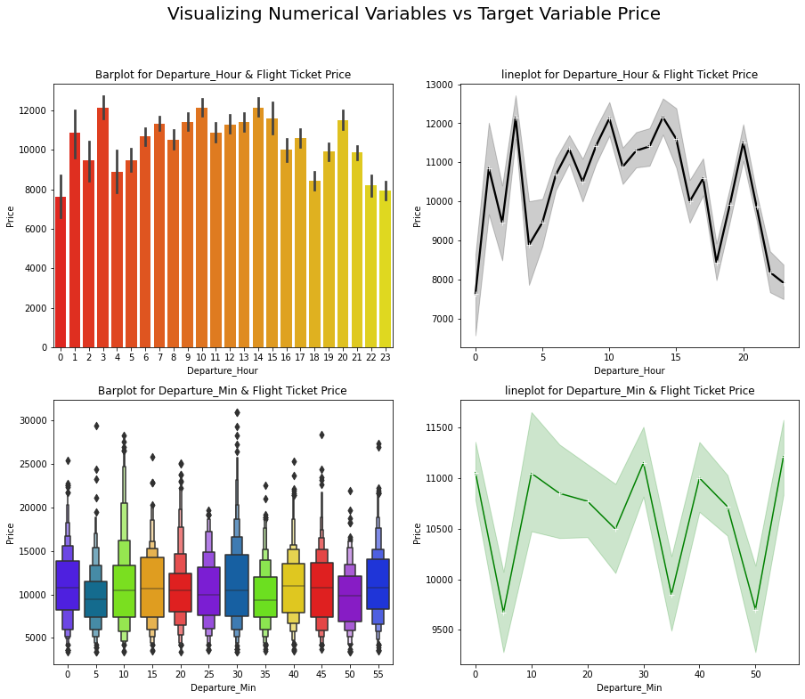
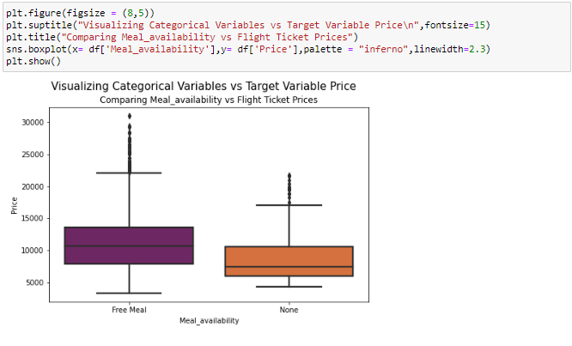
Observations:
Source vs Price: From the box plot we can observe the flights from Kolkata are having somewhat higher prices compared to other sources.
Destination vs Price: From the boxen plot we can notice that the flights travelling to Goa have higher flight ticket prices.
Observations:
Departure_Hour vs Price: From the bar plot and line plot we can see that there are some flights departing in the early morning 3 AM having most expensive ticket prices compared to late morning flights. We can also observe the flight ticket prices are higher during afternoon (may fluctuate) and it decreases in the evening.
Departure_Min vs Price: The boxen plot and line plot gives there is no significant difference between price and departure min.
Observations:
Meal_availability vs Price: The boxplot shows the flights having Free meal facility have high ticket prices.

Slide 20
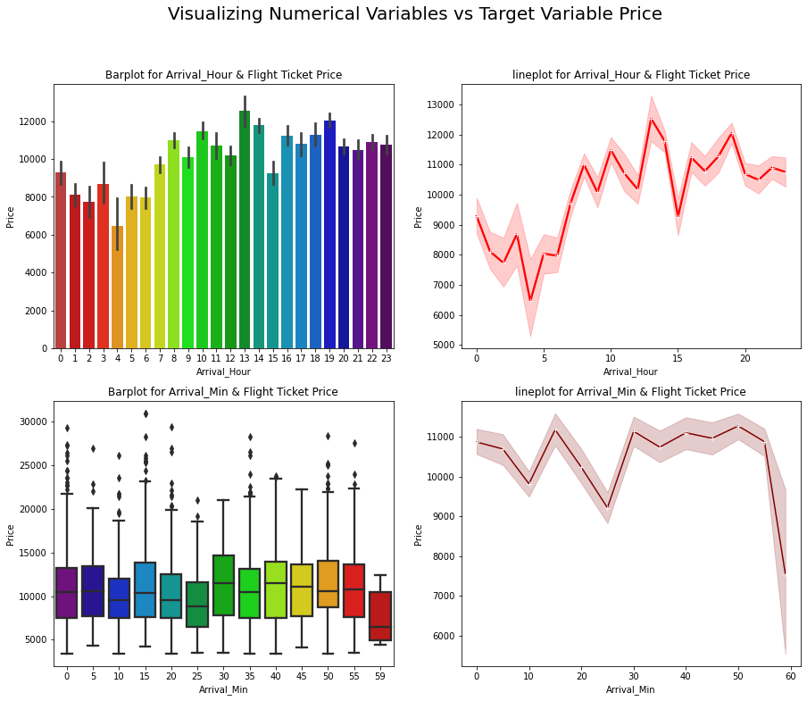
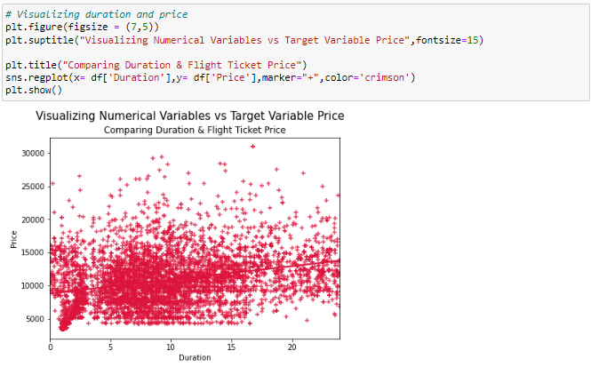
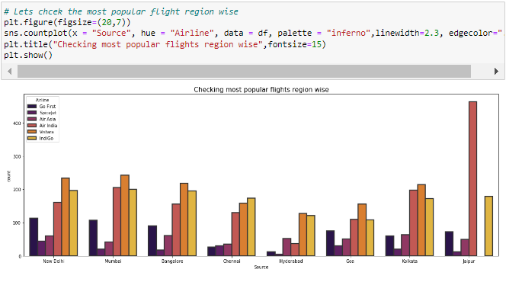
Observations:
Arrival_Hour vs Price: From the bar plot and line plot we can observe that very few flights are arriving in the early morning that is 0 to 6 AM they have very less ticket price. Also, the flights which are arriving in the afternoon and evening have somewhat higher price. So, we can conlude this column has some positive correlation with price.
Arrival_Min vs Price: There is no significant difference between this feature and price. We can say flight ticket prices are not much dependent on the Arrival_min.
Observations:
Duration vs Price: From the reg plot we can observe some positive linear relation between Duration and Price. Flights having 1-12 hours of duration, they have ticket price of around 15000.
Till now we have checked the relation between the independent variables and dependent variable that is our target column "Price". Now let's check the relation between two independent variables and compare each of them with others.
Source vs Airline: The plot showing the region wise count of airlines which tells us that Jaipur source is not having Vistara flights and it has Air India flights in higher count compared to other sources. Other sources have Air India, Vistara and Indigo flights with higher count.

Slide 21
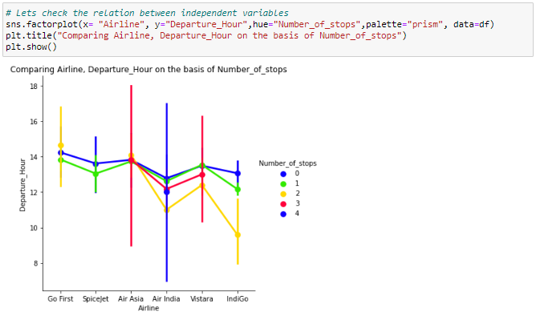
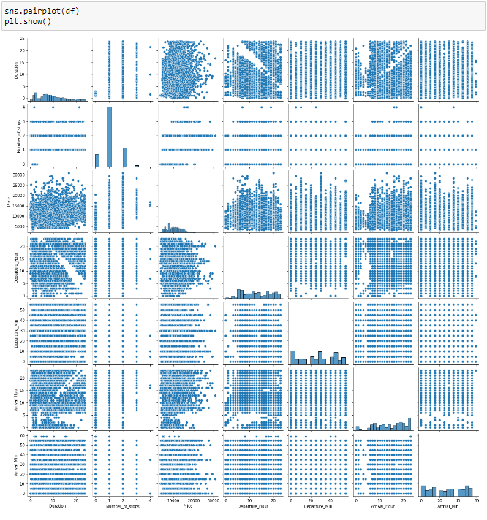
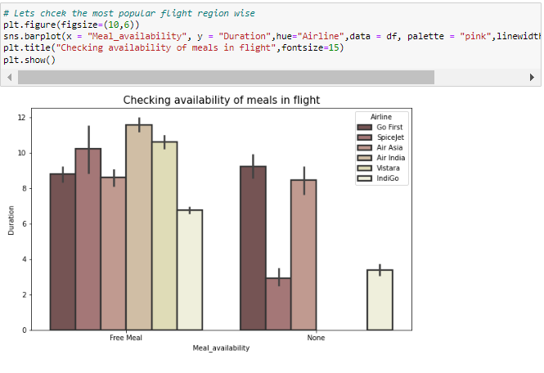
Observations:
Above plot gives the relation between Airline and Departure hour based on N-umber of stops. Air India and Air Asia flights are departing in the evening and they have less than 4 stops during the journey.
All the airlines provides free meals during the journey having the duration below 11 hours.
Observations :
This pair plot gives the pairwise relation between the columns, we can observe the relation between the features
Here we can observe the correlation between the features and on the diagonal we can notice the distribution plot which shows whether the column has skewness or not.

Slide 22
Model/s Development and evaluation

Slide 23
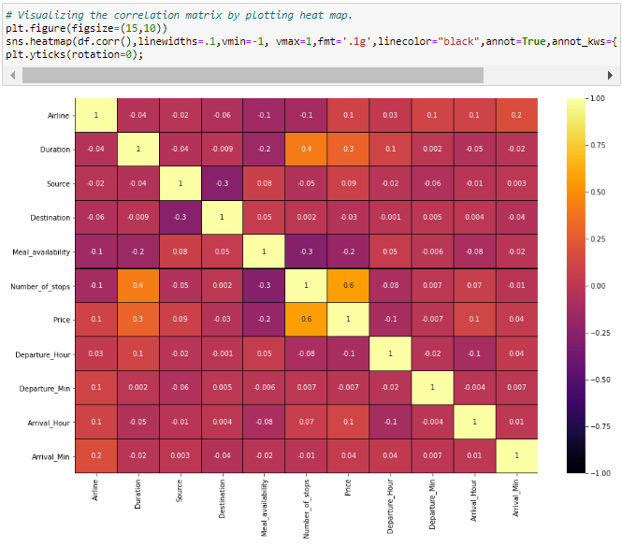
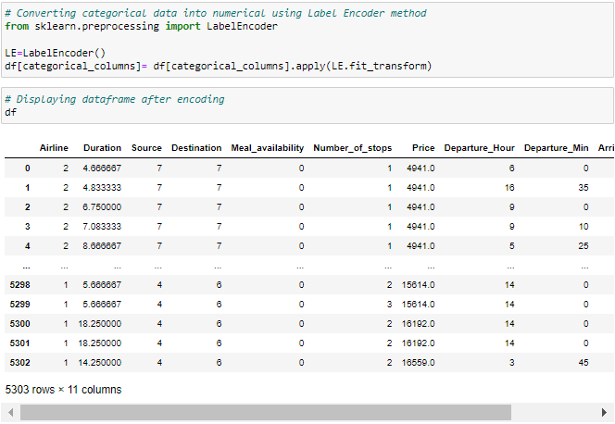
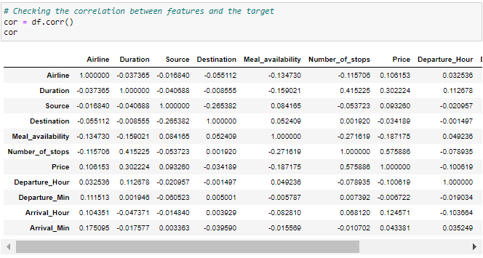
Encoding the categorical columns using Label Encoder Method
Now we have converted the categorical columns into numerical columns using label encoding method.
Correlation between the target variable and independent variables using HEAT map
This heatmap shows the correlation matrix by visualizing the data. we can observe the relation between one feature to other.
This heat map contains both positive and negative correlation.
The features Number_of_stops, Duration Arrival_Hour and Airline are highly positively correlated with the target column compared to other features.
The other features have very less correlation with the target column.
From the map we can also observe there is no multicollinearity issue exists.

Slide 30
Interpretation of the Results
Visualizations: In univariate analysis I have used count plots and pie plots to visualize the counts in categorical variables and distribution plot to visualize the numerical variables. In bivariate analysis I have used bar plots, strip plots, line plots, reg plots, box plots, and box plots to check the relation between label and the features. Used pair plot to check the pairwise relation between the features. The heat map and bar plot helped me to understand the correlation between dependent and independent features. Detected outliers and skewness with the help of box plots and distribution plots respectively. And I found some of the features skewed to right as well as to left. I got to know the count of each column using bar plots.
Pre-processing: The dataset should be cleaned and scaled to build the ML models to get good predictions. I have performed few processing steps which I have already mentioned in the pre-processing steps where all the important features are present in the dataset and ready for model building.
Model building: After cleaning and processing data, I performed train test split to build the model. I have built multiple regression models to get the accurate R2 score, and evaluation metrics like MAE, MSE and RMSE. I got Extra Trees Regressor as the best model which gives 77.47%R2score.After tuning the best model, the R2 score of Extra Trees Regressor has been increased to77.61% and also got low evaluation metrics. Finally, I saved my final model and got the good predictions results for price of flight tickets.

Slide 31
Key Findings and Conclusions of the Study
The case study aims to give an idea of applying Machine Learning algorithms to predict the price of the flight tickets. After the completion of this project, we got an insight of how to collect data, pre-processing the data, analyze the data, cleaning the data and building a model. In this study, we have used multiple machine learning models to predict the flight ticket price. We have gone through the data analysis by performing feature engineering, finding the relation between features and label through visualizations. And got the important feature and we used these features to predict the car price by building ML models. Performed hyper parameter tuning on the best model and the best model’sR2 score increased and was giving R2 score as 77.61%. We have also got good prediction results of ticket price.
Findings:
Flight ticket prices change during the morning and evening time of the day. From the distribution plots we came to know that the prices of the flight tickets are going up and down, they are not fixed at a time. Also, from this graph we found prices are increasing in large amounts.
Some flights are departing in the early morning 3 AM having most expensive ticket prices compared to late morning flights. As the time goes the flight ticket fares increased and midnight flight fares are very less (say after 10 PM). Also, from categorical and numerical plots we found that the prices are tending to go up as the time is approaching from morning to evening.
From the categorical plots (bar and box) we came to know that early morning and late-night flights are cheaper compared to working hours.
From the categorical plots we found that the flight ticket prices increaseas the person get near to departure time. That is last minute flights are very expensive.
From the bar plot we got to know that both Indigo and Spicejet airways almost having same ticket fares.
Not all flights are expensive during morning, only few flights departing in the early morning 3 AM are expensive. Apart from this the flight ticket fares are less compared to other timing flight fares.

Slide 32
Thank you

